Slide 1
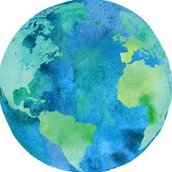
Welcome!
There are a few questions over the coming slides to prompt thoughts, ideas and reflection.
As a group, please give them your best shot – guesses are fine (no googling, please!)
When you’ve gone through the questions together you can keep scrolling through the slides to check the answers.

Slide 2

Question 1:
Representation
Which of these countries has the lowest representation for women in parliament – and which has the highest?
(a) Rwanda
(b) Ireland
(c) Iraq
(d) Ethiopia

Slide 3

Question 2:
Voting Rights
Women in this country only got full voting rights in 1990.
[Hint: the country begins with the letter S…]
S___________________

Slide 4

Question 3:
Health
What is life expectancy in Ireland?

Slide 5

Question 4:
Refuge and Migration
What percentage of Ireland’s population is living in Direct Provision, seeking asylum.

Slide 6

Question 5:
Food
True or False:
There is enough food thrown out every day in ‘Developed’ countries to feed every hungry person in the world.

Slide 7
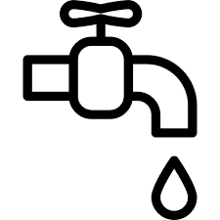
Question 6:
Water
According to the World Bank, it would cost $150 billion to provide clean water for everyone who needs it.
Globally, how much do we spend on bottled water every year?

Slide 8

Question 7:
Education
What percentage of people in Ireland struggle with basic literacy?
[*aged 15-65]

Slide 9

Question 8:
Health
Global Covid Vaccine rollout:
[Data from August 2021]
Percentage of Covid vaccines administered to people in
High and Middle Income countries _____ %
Percentage of Covid vaccines administered to people in
Low Income countries _____ %

Slide 10

What was the most valuable traded item in 15th Century Timbuktu?
Question 9:
History

Slide 11
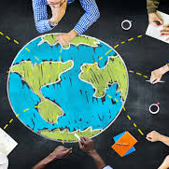
Hope you enjoyed the questions. If you’d like to take a look at the answers keep scrolling…
Remember, the point of the quiz isn’t to get the most correct answers. It actually doesn’t matter if none of the answers are correct.
The point is to think about what these questions, and our answers to them, say to us about our picture of the world.
And, to help us understand what Global Education is about.

Slide 12
Question 1:
Representation
Which country has the lowest representation for women in parliament – and which has the highest?
(a) Rwanda
(b) Ireland
(c) Iraq
(d) Ethiopia

Slide 13
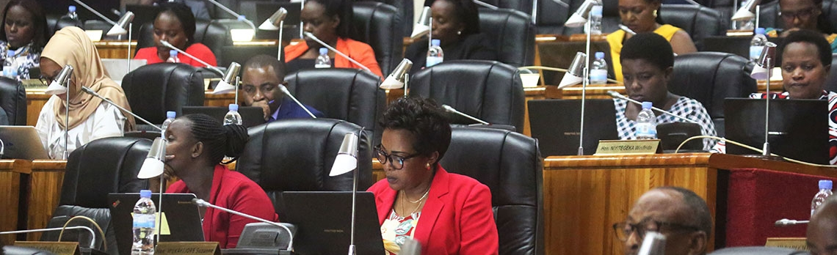
1. Lowest Level of Representation for Women in Parliament:
(b) Ireland
Photo: Sam Ngendahimana / worldbank.org
Rwanda (67.5%) has the highest, followed by Ethiopia (39%), and Iraq (26%).
Of these four countries, Ireland (24%) has the lowest representation for women in parliament. (92nd in the world, and tenth lowest in Europe).
Sources:
http://data.worldbank.org/indicator/SG.GEN.PARL.ZS
https://ec.europa.eu/eurostat/databrowser/view/sdg_05_50/default/table?lang=en
Women in Politics | Ivana Bacik

Slide 14
Question 2:
Voting Rights
Women in this country only got full voting rights in 1990
[Hint: the country begins with the letter S…]
S___________________

Slide 15
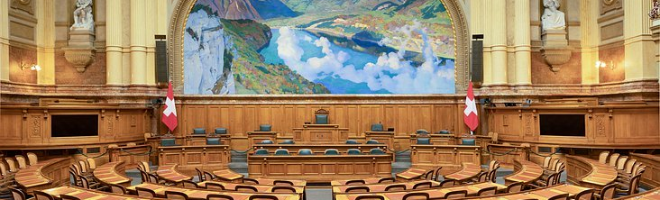
2. In which country did women get full voting rights in 1990?
Switzerland
Women in Switzerland only got full voting rights throughout the country in 1990.
Following a referendum, women gained the right to vote in general elections in 1971. 34% of the all-male electorate voted against equality. It was the second referendum on the question.
However, some districts held out and did not allow women to vote in regional elections until a legal challenge in 1989.

Slide 16
Question 3:
Health
What is life expectancy in Ireland?

Slide 17
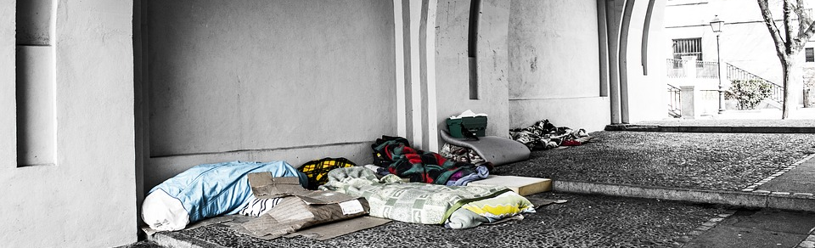
3. Life expectancy in Ireland?
Answer: Depends whose lives we’re talking about.
Average life expectancy in Ireland is 81.5 years. But whose lives are we talking about?
For Traveller men it is 61 (almost 20 years below the average figure) and 70 for Traveller women. The suicide rate for Travellers is 6 times the national average. Traveller infants aged under two are 10 times more likely to die from SIDS (Sudden Infant Death Syndrome) or congenital diseases than in the settled community.
In Ireland the mean age of death for a homeless woman is 38, and 44 for men. People who are homeless have an average life span of 42.
Central African Republic has the lowest life expectancy in the world, at 54 (2022).
www.independent.ie/irish-news/travellers-life-expectancy-still-lags-far-behind-26677596.html
www.irishexaminer.com/ireland/urgent-need-for-traveller-mental-health-services-with-suicide-rates-six-times-the-national-average-378557.html
www.irishexaminer.com/ireland/homeless-people-have-an-average-lifespan-of-just-42-422638.html

Slide 18
Question 4:
Refuge and Migration
People seeking asylum in DP make up what percentage of the overall population of Ireland?

Slide 19
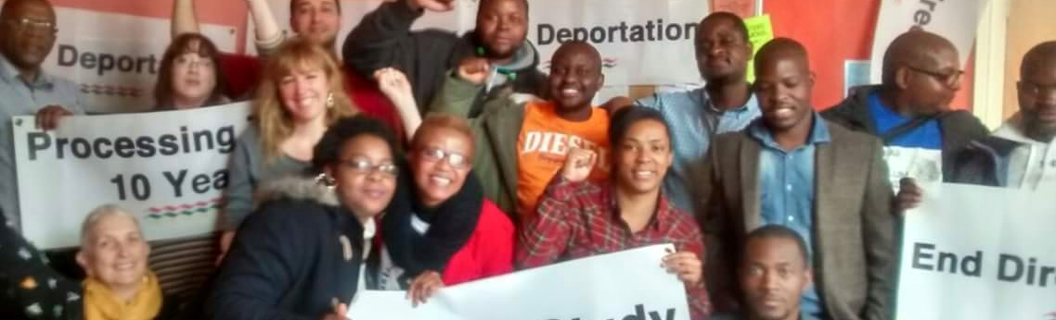
4. People in DP make up approximately 0.15% of the overall population of Ireland.
As of May 2020, there were about 7,700 people living in Direct Provision = 0.15% of the overall population.
Direct Provision is the controversial system of accommodation for people seeking asylum in Ireland, providing for basic needs and a small allowance. There are numerous barriers and restrictions placed on people (including the right to work, to study, access to a driving license, difficulty opening a bank account, and limits on many freedoms and decisions about everyday life).
People are often obliged to live in DP for many years while waiting for a decision on their application for International Protection. Some children have spent their whole lives in the system.

Slide 20
Question 5:
Food
True or False:
There is enough food thrown out every day in ‘Developed’ countries to feed every hungry person in the world.

Slide 21
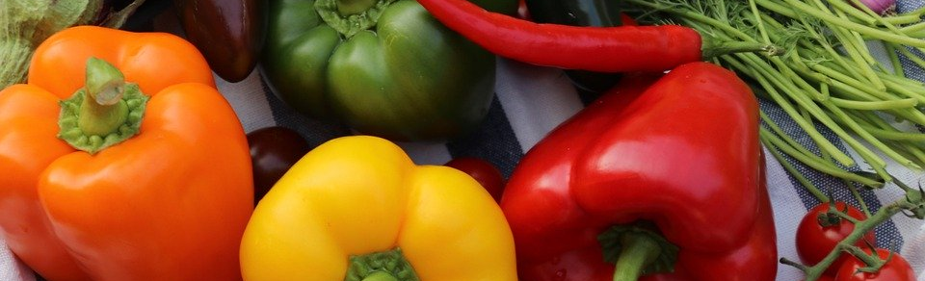
5: Food Waste
True – three times over.
The ‘Developed World’ throws out three times enough food every day to feed every hungry person in the world.
Consumers in ‘Developed’ countries throw away 222 metric tonnes of food a year – the equivalent of the entire production of Sub-Saharan Africa.
www.irishtimes.com/news/environment/the-battle-against-food-waste-1.3425288

Slide 22
Question 6:
Water
According to the World Bank, it would cost $150 billion to provide clean water for everyone who needs it.
Globally, how much do we spend on bottled water every year?

Slide 23
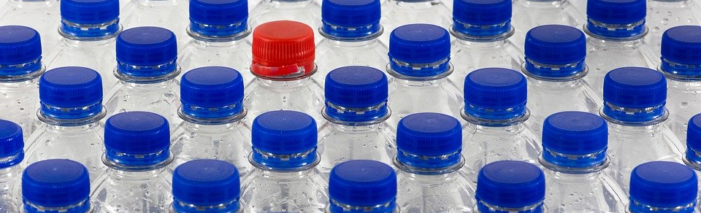
6. Global spending on bottled water every year?
$300 billion.
World Bank estimate of providing clean water for all: $150 billion.
Annual global revenue from bottle water:
over $300 billion.
The UN estimates that 1,800 children under the age of 5 die every day for lack of access to clean water.

Slide 24
Question 7:
Education
What percentage of people in Ireland struggle with basic literacy?
[*aged 15-65]

Slide 25
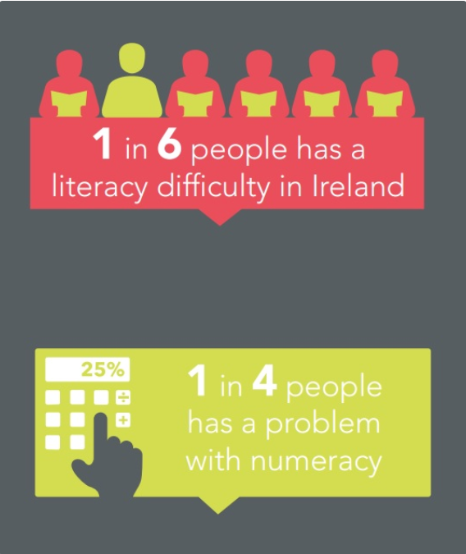
Question 7 / Education
Answer: 18% of adults struggle with basic literacy.
The OECD Adult Skills Survey shows that 18% or about 1 in 6, Irish adults are at or below level 1 on a five-level literacy scale.
At this level a person may be unable to understand basic written information.
25% or 1 in 4 Irish adults may have problems doing simple math calculations.
Literacy and numeracy in Ireland - Nala

Slide 26
Question 8:
Health
Global Covid Vaccine rollout:
[Data from August 2021]
Percentage of Covid vaccines administered to people in
High and Middle Income countries _____ %
Percentage of Covid vaccines administered to people in
Low Income countries _____ %

Slide 27
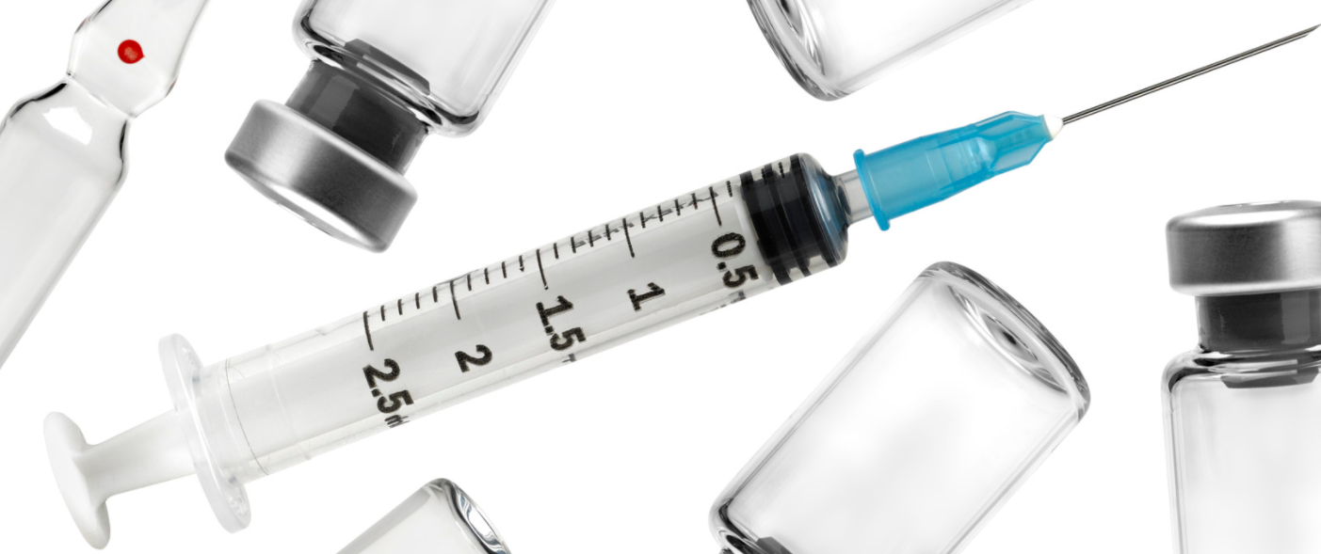
7.
84% doses administered in high and upper middle-income countries.
0.3% in low-income countries
By August 2021, 84% of Covid vaccine doses administered had gone to people in high and upper middle-income countries, while 0.3% have been administered in low-income countries.
In the first month of the vaccine rollout the World Health Organisation (WHO) claimed that while 39 million Covid vaccines have been delivered in high income countries, only 25 went to low-income countries. Not 25 million - just 25. (January 2021)
A year later, by January 2022 78% of people in high income countries had received at least one dose, compared to 11% in low income countries.
While vaccine rollout is complex queue jumping, hoarding, and price undercutting on the part of 'developed countries’ have all played a roll in vaccine inequality.
Raka Banerjee, World Bank Group Development Podcast:
www.worldbank.org/en/news/podcast/2021/07/30/-absolutely-unacceptable-vaccination-rates-in-developing-countries-the-development-podcast

Slide 28
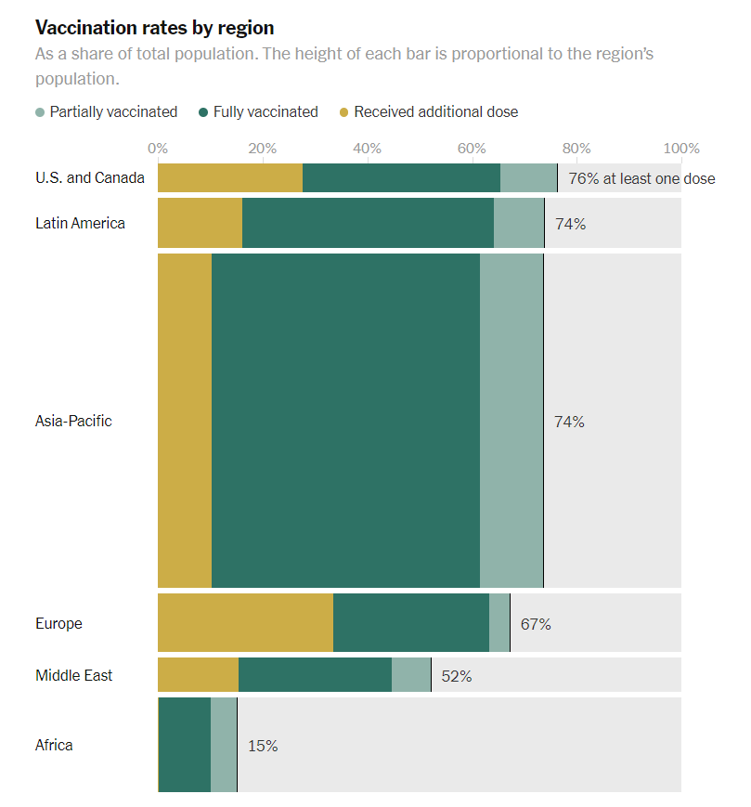

Slide 29
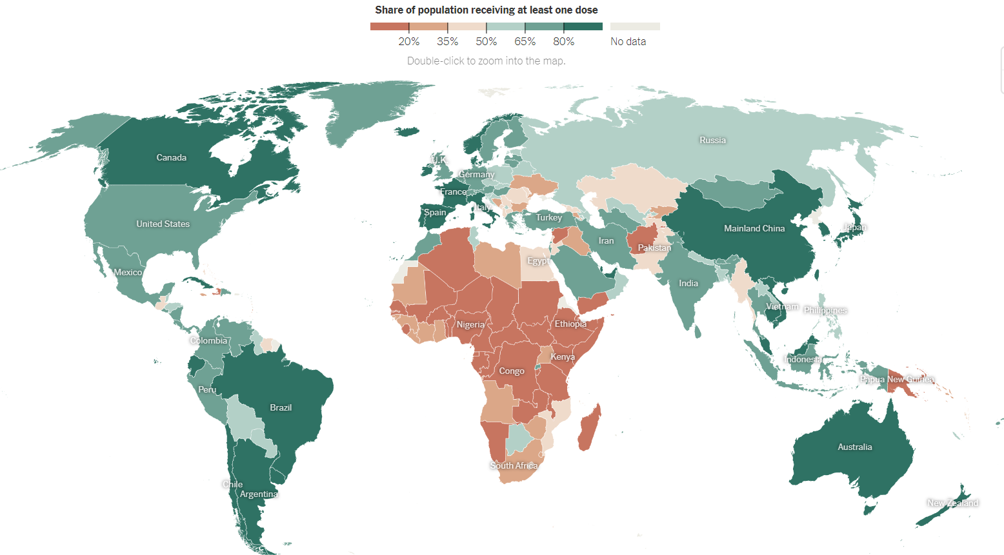

Slide 30
What was the most valuable traded item in 15th Century Timbuktu?
Question 9:
History

Slide 31
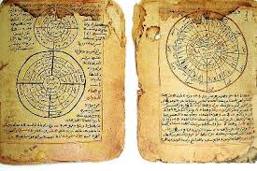
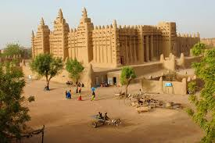
Question 9.
The most valuable traded item in
15th century Timbuktu: Books
Timbuktu was founded in the 5th century. By the15th and 16th centuries Timbuktu was an important centre for Islamic culture.
One of the earliest Universities in the world was founded in Sankore, Timbuktu. At its height, the universities had over 25,000 students (in a city with a population of 100,000) and a library holding between 400,000 - 700,000 manuscripts.

Slide 32
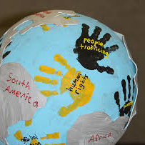
Reflection
If you have time, please take a couple of minutes to talk as a group and consider sharing your thoughts, insights, or responses to these questions with the large group:
“What most surprised us…”
How you think the quiz relates to global youth work (if at all).

